Slide 1

Finite element workshop day 1

Slide 2
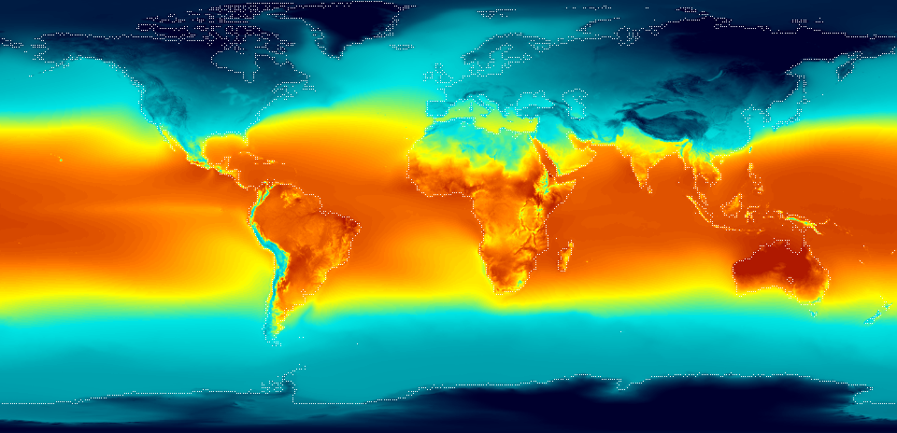
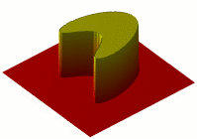
Fields
Temperature
Scalar Fields
Heat Equation

Slide 3
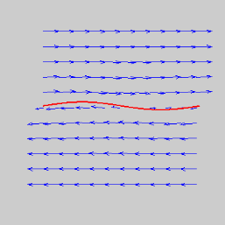
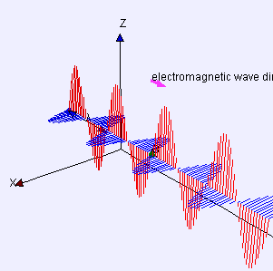
Fields
Vector FieldS
Velocity Field
Electromagnetic Field

Slide 4
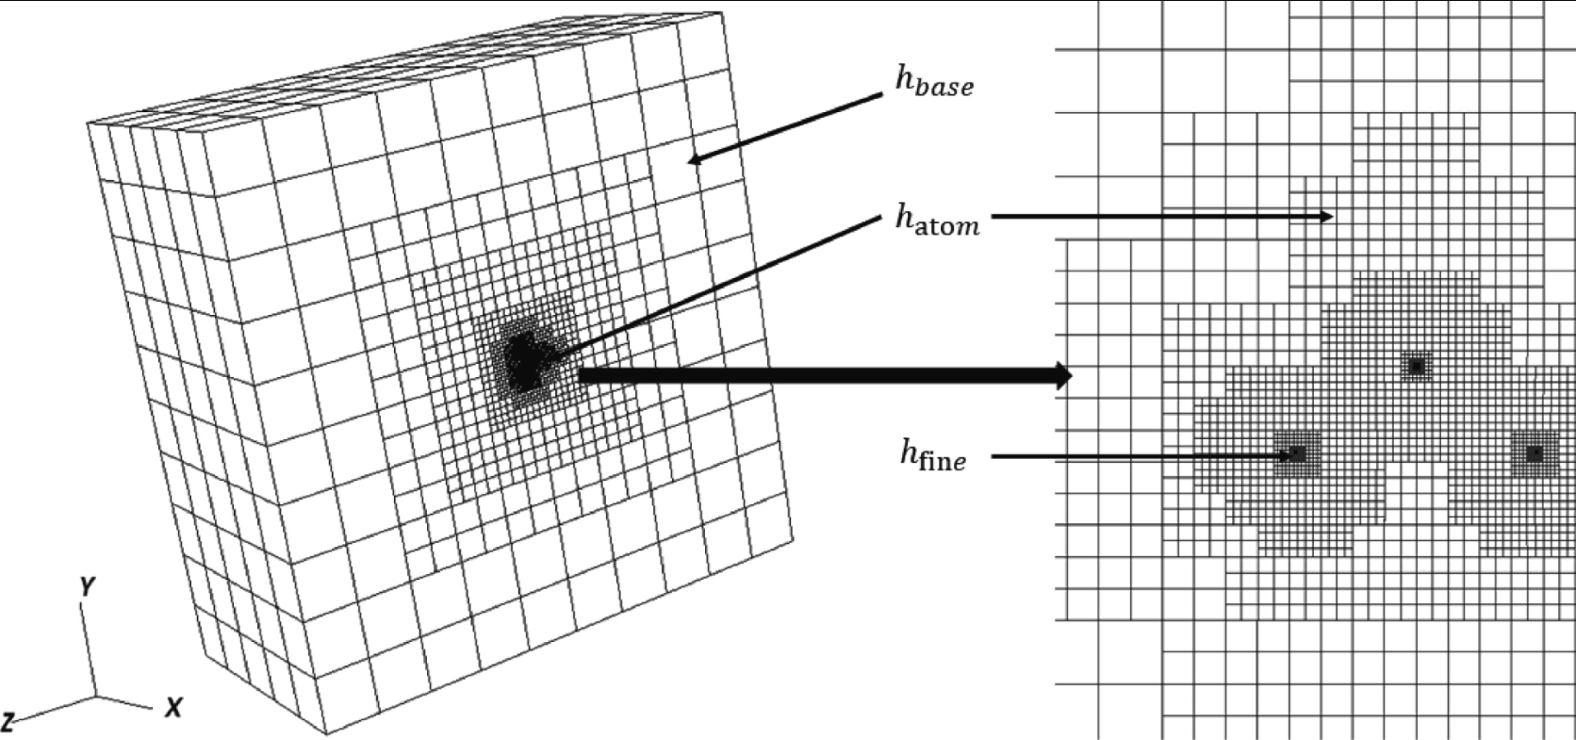
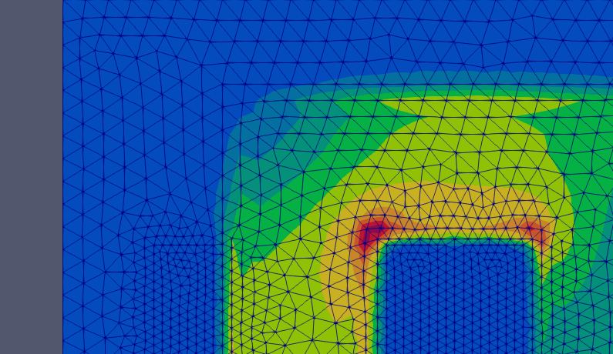
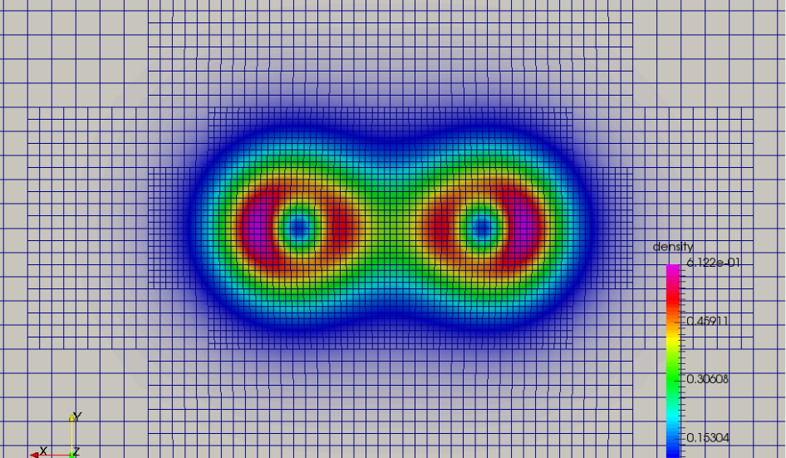
MESH

Slide 5
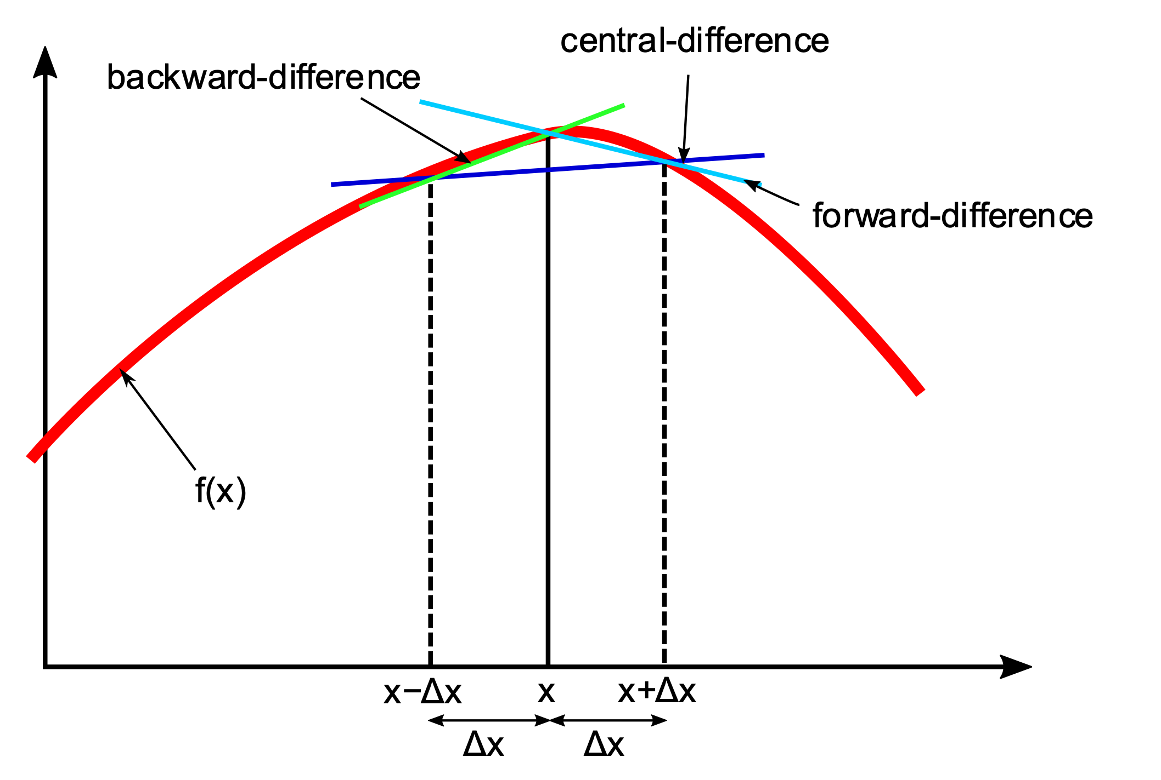
FINITE DIFFERENCE
Different Schemes

Slide 6
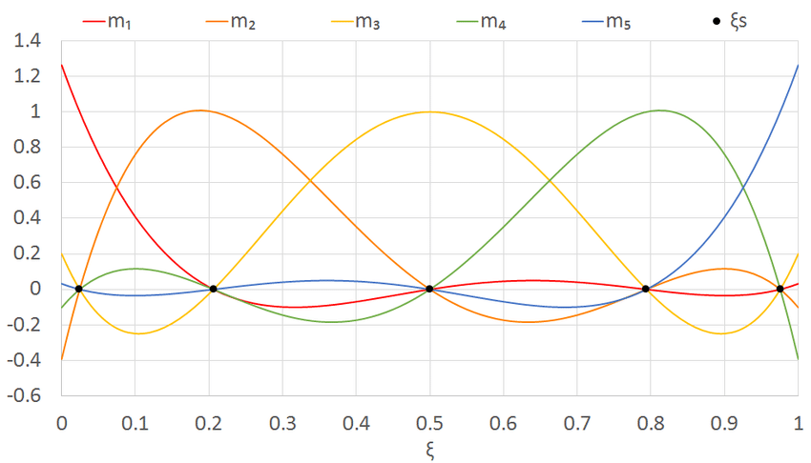
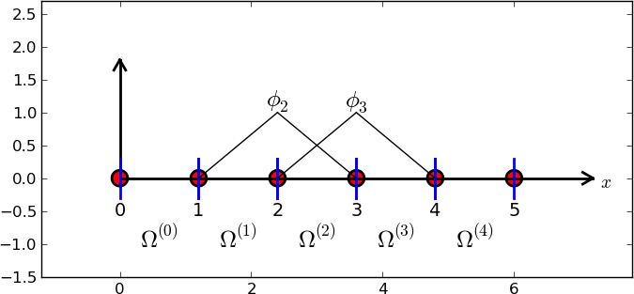
BASIS Functions
HAT FUNCTION (LINEAR)
LAGRANGE POLYNOMIAL (DEGREE 5)

Slide 7
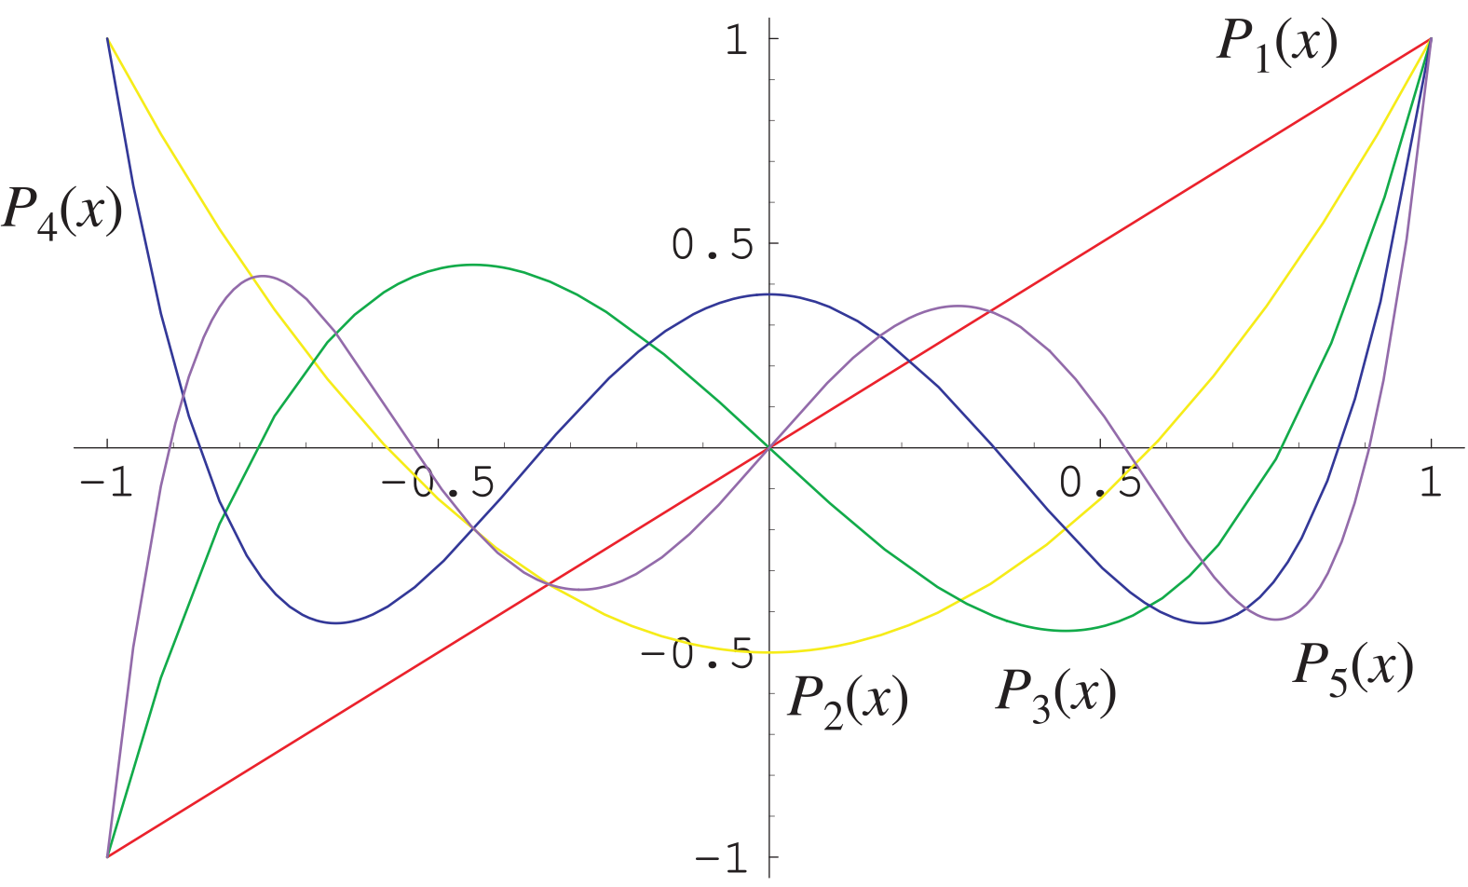
BASIS FUNCTIONS
Legendre Polynomials (Orthogonal Basis)

Slide 8
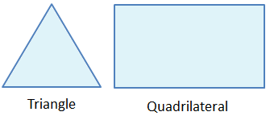
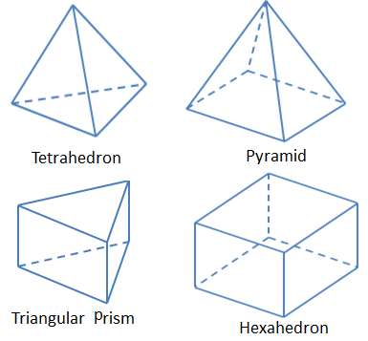
SHAPES OF ELEMENTS
2D Mesh Element
3D Mesh Element

Slide 9
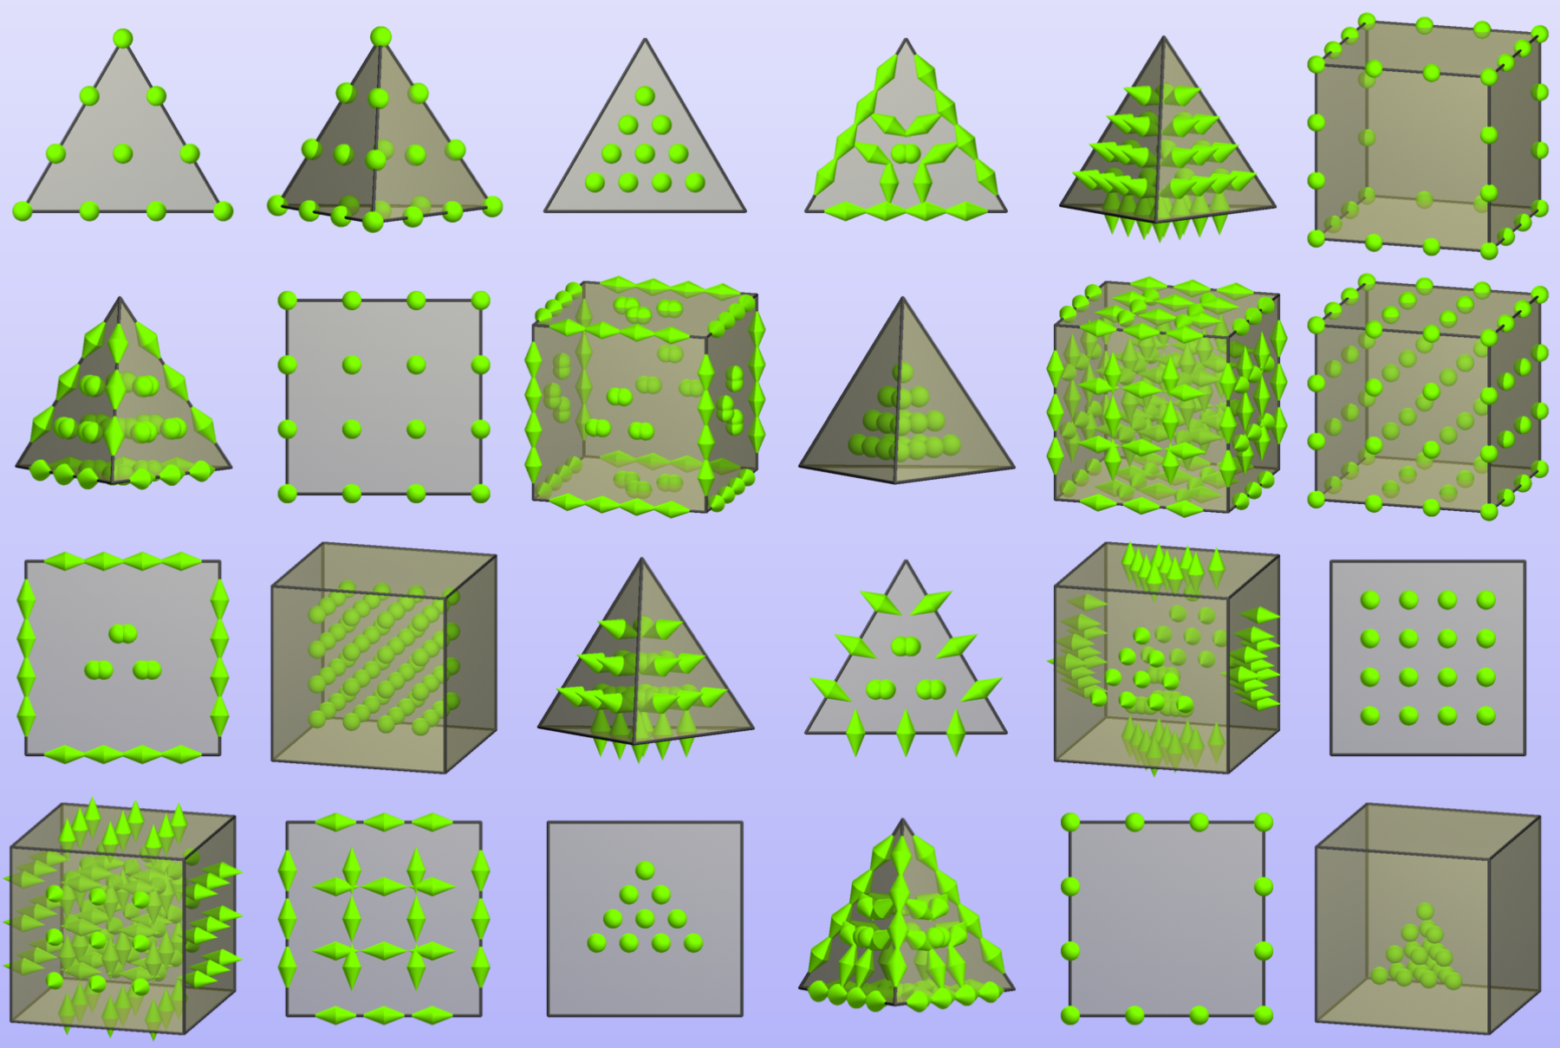
SHAPES OF ELEMENTS

Slide 10

Sources
Wikipedia
UCLA Math - https://www.math.ucla.edu/~yanovsky/Research/VortexSheets/VS1/
Radiant Energy - https://energyeducation.ca/encyclopedia/Radiant_energy
DFT-FE - https://www.sciencedirect.com/science/article/abs/pii/S0010465519302309
FEniCSx - https://fenicsproject.org/
Introduction to Finite Elements - https://hplgit.github.io/INF5620/doc/pub/H14/fem/html/._main_fem004.html
ResearchGate - https://www.researchgate.net/figure/Lagrange-polynomials-for-5-solution-points-N-5_fig28_314236855
Wolfram MathWorld - https://mathworld.wolfram.com/LegendrePolynomial.html
Periodic Table of Finite Elements - https://fenicsproject.org/pub/workshops/fenics13/slides/Arnold.pdf

